Slide 1
Chapter 5
Buddhism

Slide 2
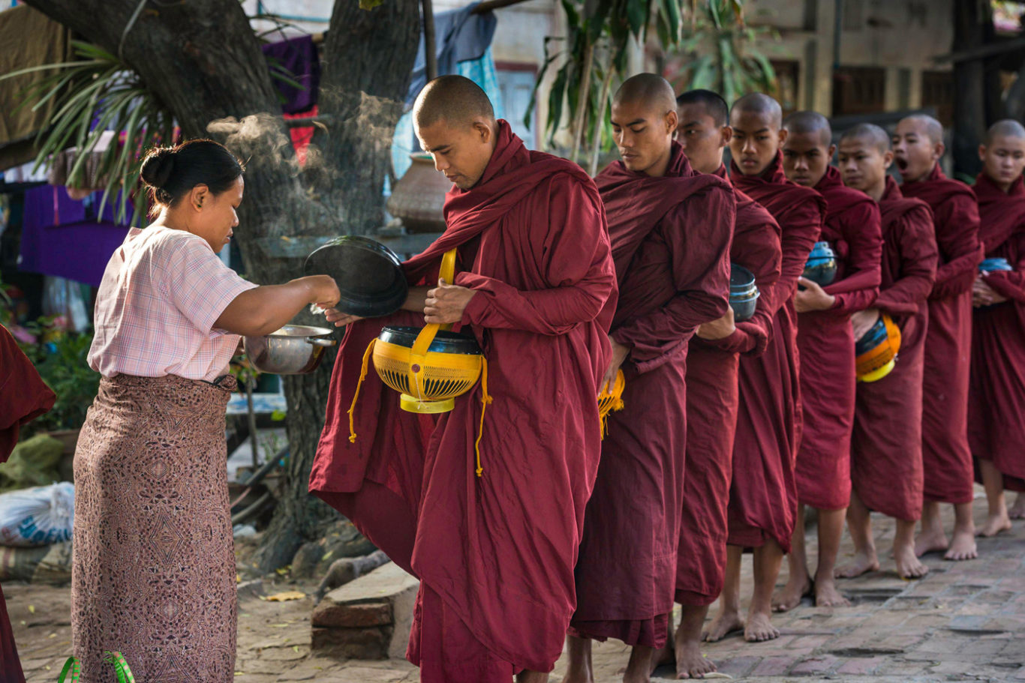
10 Misconceptions about Buddhism
AA laywoman is on the left giving offerings of food to monks on the right.

Slide 3
1. All Buddhists meditate.
Meditation is often identiﬁed as the central practice of Buddhism. However, the majority of Buddhists throughout history have not meditated. Meditation has traditionally been considered a monastic practice, and even then as a specialty only of certain monks. It is only since the 20th century that the practice of meditation has begun to be widely practiced by laypeople.

Slide 4
2. The primary form of Buddhist meditation is mindfulness.
In fact, there are hundreds of forms of Buddhist meditation, some for developing deep states of concentration and mental bliss, some for analyzing the constituents of mind and body to ﬁnd that there is no self, some for meeting the Buddha face-to-face. The practice of mindfulness as it is taught in America today began in Burma in the early 20th century.

Slide 5
3. All Buddhists are vegetarians.
Bhikshu, the Sanskrit term translated as “monk,” literally means “beggar.” Buddhist monks and nuns originally begged for their daily meal (some still do) and therefore were supposed to eat whatever was oﬀered to them, including meat.
According to some sources, the bout of dysentery that the Buddha suﬀered before he entered nirvana occurred after he ate pork.
In the centuries after the Buddha’s death, vegetarianism began to be promoted in some Buddhist texts. However, even today not all Buddhist monks and nuns are vegetarians. For example, in China they are; in Tibet they are not.

Slide 6
4. All Buddhists are paciﬁsts.
It is often said that a war has never been fought in the name of Buddhism. It is unclear what “in the name of” might mean, but there have been many battles between Buddhists (with some Buddhist monasteries having their own armies).
There have also been wars of Buddhists against non-Buddhists.
Tibetan Buddhists fought bravely against British forces that invaded Tibet. During World War II, many Japanese priests supported the military expansion of the Japanese empire.

Slide 7
5. Buddhism is a philosophy and not a religion
Buddhism has many philosophical schools, with a sophistication equal to that of any philosophical school that developed in Europe.
However, Buddhism is a religion by any deﬁnition of that indeﬁnable term, unless one deﬁnes religion as belief in a creator God.
The great majority of Buddhist practice over history, for both monks and laypeople, has been focused on a good rebirth in the next lifetime, whether for oneself, for one’s family, or for all beings in the universe.

Slide 8
6. The Buddha was a human being, not a god, and the religion he founded has no place for the worship of gods.
Buddhism has an elaborate pantheon of celestial beings (devas; the name is etymologically related to the English word divinity) and advanced spiritual beings (bodhisattvas and buddhas), who occupy various heavens and pure lands and who respond to the prayers of the devout.

Slide 9
7. Zen rejects conventional Buddhism.
Zen masters burn statues of the Buddha, scorn the sutras, and regularly frequent bars and brothels. Zen monks follow a strict set of regulations, called “pure rules,” which are based on the monastic discipline imported from India.

Slide 10
7. Zen rejects conventional Buddhism.
Most Zen monks have engaged in extensive study of Buddhist scriptures before beginning their training in the meditation hall. And although a celebrated verse in Zen speaks of “not relying on words and letters,” Zen has the largest body of written literature of any tradition of East Asian Buddhism.

Slide 11
8. The four noble truths are noble
The famous phrase “four noble truths” is a mistranslation. The term “noble” in Sanskrit is aryan, a perfectly good word meaning “noble “ or “superior” that was ruined by the Nazis. Aryan is a technical term in Buddhism, referring to someone who has had direct experience of the truth and will never again be reborn as an animal, ghost, or hell being.

Slide 12
8. The four noble truths are noble
The four truths of suﬀering, origin, cessation, and path are true for such enlightened beings. They are not true for us; we don’t understand that life is suﬀering. So the term means the “four truths for the [spiritually] noble.”

Slide 13
9. Zen is dedicated to the experience of “sudden enlightenment”
The notion that “sudden enlightenment” frees its followers from the extended regimens of training in ethics, meditation, and wisdom found in conventional forms of Buddhism.
Zen monks routinely expect to spend decades in full-time practice before they will be able to make real progress in their meditation.

Slide 14
10. All spiritual traditions, Buddhism included, are diﬀerent paths to the same mountaintop.
Many great Buddhist ﬁgures state unequivocally that enlightenment is accessible only to those who follow the Buddhist path. One can get only so far (generally, rebirth in heaven) by following other religions; only Buddhism has the path to liberation from suﬀering. All roads may lead to the base camp, but only Buddhism leads to the summit.

Slide 15
Three Jewels in Buddhism
The Buddha
The Dharma – His Teaching
The Sangha “Community”
Laymen
Laywomen
Monks
Nuns

Slide 16
Learning Objectives (1 of 2)
5.1 Tell the story of the Buddha’s enlightenment.
5.2 Define the Four Noble Truths and the Noble Eightfold Path to liberation.
5.3 Differentiate between Theravada and Mahayana Buddhism.
5.4 Identify the schools of Mahayana in East Asia.

Slide 17
Learning Objectives (2 of 2)
5.5 Contrast Vajrayana with Theravada and Mahayana Buddhism.
5.6 Describe the major Buddhist festivals.
5.7 Discuss the growing popularity of Buddhism in Western societies.
5.8 Outline the emerging focus on social problems in contemporary Buddhist practice.

Slide 18
Introduction
Mahavira was teaching Jainism while Siddhartha Gautama, the man who eventually became known as the Buddha, preached an alternative to the ritual-oriented Brahmanism of India
The Buddha taught about earthly suffering and its cure.
The Buddha taught that freedom comes when we understand how suffering is created for ourselves.

Slide 19
Introduction
Buddha’s teachings are profoundly philosophical for some and meaningful as a system of religious practice or way of life for others.
Buddha’s teaching spread from India throughout Asia and became the dominant religious tradition in many countries.
As Buddhism spread, the religion took on new forms, often reflecting earlier local traditions.
Today, the West has taken a considerable interest in Buddhism where its psychological and meditative aspects are often emphasized.

Slide 20
Introduction
“Buddha” is a generic term meaning “Awakened One.”
Buddha was a historical figure—however, what we know about him comes from stories passed down generationally through oral transmission, such as monks chanting from memory.
Buddha’s teachings were collected several hundred years after his death.

Slide 21
The life and legend of the Buddha (1 of 4)
Dates of the Life of the Buddha
566-486 BCE (traditional date)
c. 480-c. 400 BCE (modern scholars)
Sources for the Life of the Buddha
Biographical fragments in canonical texts
‘Biographies’ approximately 400 years after death
Late Biographies

Slide 22
Introduction
Historical facts about Buddha’s life are sparse. Four centuries after the Buddha’s death, poets wrote biographies about the Buddha venerating him as a legendary hero.
An example of this is the Buddhacharita (Acts of the Buddha).

Slide 23
5.1 The life and legend of the Buddha
The sacred biographies of the Buddha provide a useful basis for comparison with other sacred biographies, such as the biblical accounts of the lives of Moses and Jesus.
Buddhism develops within the context of Hinduism, building on and challenging some of its ideas.

Slide 24
5.1 The life and legend of the Buddha
Unconvinced of the value of his life of ease, Siddhartha encountered the “four sights” that his father tried to hide from him:
a bent, aged man;
a sick person;
a corpse;
and a monk devoted to the eternal rather than transient pleasure.

Slide 25
5.1 The life and legend of the Buddha
Siddhartha Gautama (means “wish-fulfiller”) was born in the garden of Lumbini near Kapilavastu, near what is now the border between India and Nepal, and lived for more than 80 years during the fifth century BCE, though his life may have extended either into the late sixth or early fourth century.
Siddhartha’s birth story is embellished as a conception without human intercourse, in which a white elephant carrying a lotus flower entered his mother’s womb during a dream.

Slide 26
5.1 The life and legend of the Buddha
Siddhartha’s father was a wealthy landowner serving as a chief of the Shakyas who lived in the foothills of the Himalayas. He tried to protect his son from the troubles of the world.
Siddhartha married Yashodhara, and they had a son named Rahula (means “fetter”).

Slide 27
5.1 The life and legend of the Buddha
Dismayed with the impermanence of life and interested in a life of renunciation, at age 29 he renounced his wealth and left his wife and newborn son for a wandering life in pursuit of finding the way to total liberation from suffering.
Various traditions report the story of Siddhartha’s travels. He studied with Hindu yogis and tried pushing his body to the limits of asceticism, fasting until he came close to death. After six years, Siddhartha did not find the answers to his questions about the nature of human existence in these extreme lifestyles.

Slide 28
5.1 The life and legend of the Buddha
Eventually, Siddhartha advocated the Middle Way of neither self-indulgence nor self-denial.
In the sixth lunar month, under the full moon, Siddhartha sat in deep meditation beneath a tree in a village now called Bodh Gaya and experienced supreme awakening.
After passing through four states of serene contemplation, he recalled all of his previous lives and then had a realization of the wheel of repeated death and rebirth. Finally realizing the cause of suffering and the means of ending it, he experienced enlightenment.

Slide 29
5.1 The life and legend of the Buddha
After this enlightenment, Siddhartha was tempted by the evil personified in the form of Mara to keep these insights to himself, and Siddhartha himself feared that nobody else could possibly understand what he now knew.
After this awakening, Siddhartha became the Buddha, the one who woke up. He is also known as Shakyamuni Buddha, or “sage of the Shakya clan.”

Slide 30
5.1 The life and legend of the Buddha
The Buddha spent the next forty-five years traveling and teaching throughout India.
His teaching or Dharma (Pali: dhamma) included the Four Noble Truths, the Noble Eightfold Path, the Three Marks of Existence, and other guidelines for achieving liberation from suffering.
He gave his teaching to people of all sects and social classes.

Slide 31
5.1 The life and legend of the Buddha
Some followers became bhikshus (monks; the Pali form of this word is bhikkhu).
Later, women were allowed to pursue a life of renunciation as well (becoming bhikshunis; Pali: bhikkhunis), although the Buddha was somewhat reluctant to allow this, he agreed only with the provision that nuns follow eight special rules.
The order of the Buddha’s disciples, known as the Sangha, made no distinctions on the basis of caste.

Slide 32
Eight Special Rules for bhikshunis
(1) even though the time since her ordination may be as long as one hundred years, a nun must pay respect even to a monk who has just been ordained into the Buddhist Order;
(2) she must not slander a monk;
(3) she must not accuse a monk of any misdeed;
(4) she must receive from a monk the entire commandments for nuns;

Slide 33
Eight Special Rules for bhikshunis
(5) she must confess her offenses before the assembly of monks and accordingly make amends;
(6) she must ask for instruction from a monk every half month;
(7) she must not spend the summer retreat at a place where there are no monks; and
(8) after the summer retreat she must confess her offenses to a monk and make amends.

Slide 34
5.1 The life and legend of the Buddha
At the age of eighty, the Buddha accepted an offering of food—either a poisonous mushroom or spoiled pork, a matter of some linguistic debate—and became ill.
Knowing that he would soon die, he told his followers to be responsible for their own spiritual development.
The Buddha’s followers cremated his body, and the relics were distributed among seven clans, who built memorial domes, or stupas, over them. Stupas became important pilgrimage sites.

Slide 35
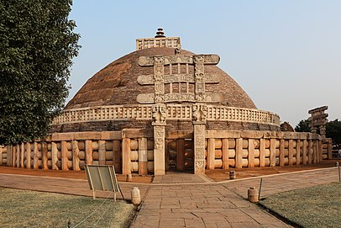
Stupas

Slide 36
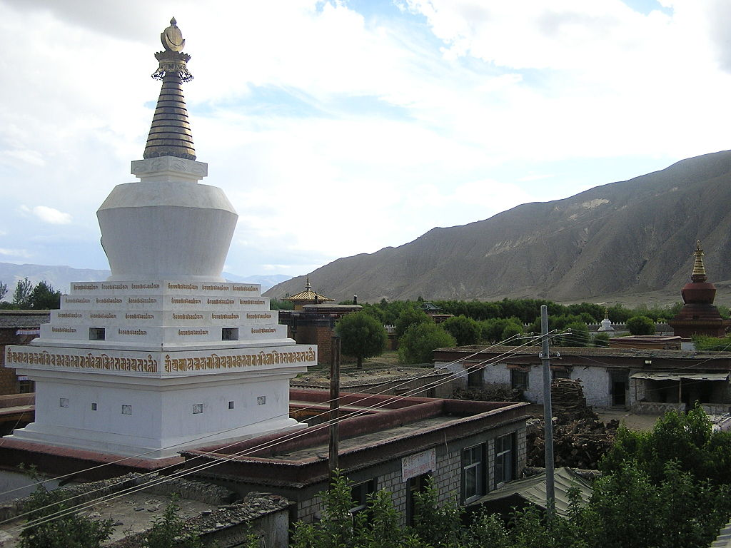
Stupas

Slide 37
5.2 The Dharma
Please remember how the term dharma is used in Hinduism and note that it takes on a different shade of meaning in Buddhism, referring to the “law” or “teachings” of the Buddha.
Buddhism is often referred to as a nontheistic religion. Many forms of Buddhism emphasize that they do not worship the Buddha as a divine figure but rather revere him as a teacher who left a path for others to follow, or a raft that carried practitioners to the farther shore of nirvana (Pali: nibbana), or liberation

Slide 38
5.2 The Four Noble Truths
The term translated here as “suffering” is dukkha.
The Buddhist understanding of suffering goes beyond the connotations of the English term.
Suffering is not simply being miserable, but a function of the impermanence of everything in life.
Thus even the greatest happiness is temporary; even when one’s life is going well, there are nagging fears that something or someone cannot last.

Slide 39
5.2 The Four Noble Truths
In his very first sermon at Sarnath, the Buddha set forth the Four Noble Truths, the foundation for all his later teachings:
1. Life inevitably involves suffering, dissatisfaction, and distress.
2. Suffering (dukkha) is caused by craving, rooted in ignorance.
3. Suffering will cease when craving ceases
4. There is a way to realize this state: the Noble Eightfold Path.

Slide 40
5.2 The First Noble Truth
The concept of dukkha extends to the Buddhist understanding of self as well; while Hindu tradition of the time sought knowledge of the eternal soul or atman, the Buddha, through his own meditative practice, found no such entity, and instead taught that there is no permanent self.
Rather, the self is a changing bundle of fleeting feelings, sense impressions, ideas, and evanescent physical matter.

Slide 41
5.2 The Second Noble Truth
The Second Noble Truth asserts that suffering arises from desires, because we seek satisfaction and permanence in our lives, even though, according to the Buddha, no permanent satisfaction is possible.
The origin of suffering is craving and clinging in ignorance to things that people mistake as permanent but that are in truth impermanent.

Slide 42
5.2 The Second Noble Truth
The Buddha taught that instead, people should recognize Three Marks of Existence:
dukkha (suffering),
anitya (impermanence; Pali: anicca),
and anatman (no immortal self;
An easy way to help us remember this term and what it means is to remind them that the correct pronunciation is “un – atman,” that is, no atman as taught in the Hindu Upanishads).

Slide 43
5.2 The Third Noble Truth
The Third Noble Truth—that suffering ceases when desire ceases—is straightforward enough, though difficult to imagine (imagine what it would be like to a live without acting on the basis of desire).
Finally, the Fourth Noble Truth leads into yet another list, the Noble Eightfold Path, which incorporates morality, concentration, and wisdom as the means to extinguishing (the literal meaning of nirvana) desire and suffering.

Slide 44
5.2 The Fourth Noble Truth
Buddhism, while rejecting the Hindu concept of atman, does retain the concept of a cycle of death and rebirth governed by karma.
Escape from this cycle may be sought through following the steps on the Noble Eightfold Path

Slide 45
5.2 The Noble Eightfold Path
1. Right Understanding: Realize and understand the Four Noble Truths.
2. Right Thought or Motives: Uncover any unwholesome roots in one’s thinking; eliminate self-centeredness.
3. Right Speech: Abstain from lying, gossiping, speaking harshly, or using divisive speech.
4. Right Action: Observe the Five Precepts, namely, avoid destroying life, stealing, sexual misconduct, lying, and intoxicants.

Slide 46
5.2 The Noble Eightfold Path
5. Right Livelihood: Make a living without violating the Five Precepts.
6. Right Effort: Eliminate impurities of the mind and cultivate wholesome actions.
7. Right Mindfulness: Be aware in every moment; discipline the mind.
8. Right Meditation: Quiet the mind through mental discipline.

Slide 47
5.2 The wheel of birth and death
The concept of a cycle of birth and death in Buddhism necessarily differs from the Hindu concept because Buddhism teaches that there is no eternal soul to be reborn.
It is challenging to imagine how rebirth occurs if there is nothing other than accumulated karma to be reborn.
n Buddhism, the impressions of our virtuous and nonvirtuous actions shape our experience moment by moment.
When we die, this process continues, passing on the flame to a new life in a realm of existence that reflects our past karma.

Slide 48
5.2 The wheel of birth and death
The three root afflictions of attachment, aversion, and delusion drive the wheel of birth and death.
Cultivating the opposites of these evils helps one move toward escape.
It is said that the Buddha could see all his own past lives.
Buddhist tradition remembers that he subsequently used the stories about his previous lives to teach moral lessons known as the Jataka Tales.

Slide 49
5.2 The wheel of birth and death
Buddhist cosmology describes multiple planes of existence, including realms of hells, hungry ghosts, animals, humans, and gods.
Buddhism acknowledges the existence of various gods but understands them to be subject to the same imperfections and impermanence as humans are.

Slide 50
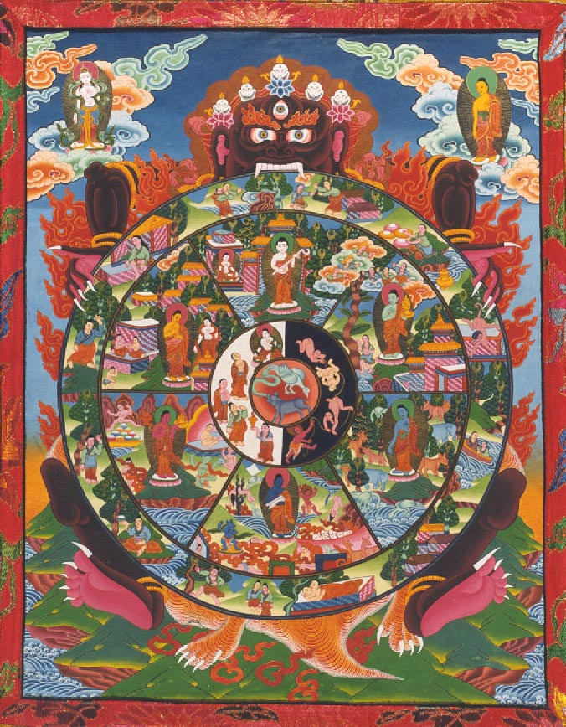
The Wheel of Rebirth

Slide 51
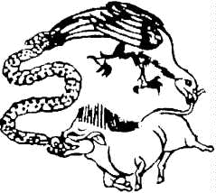
Three Fundamental “Defilements” or “Poisons”
Delusion or ignorance – boar
Dislike or hatred – snake
Desire or greed– rooster

Slide 52
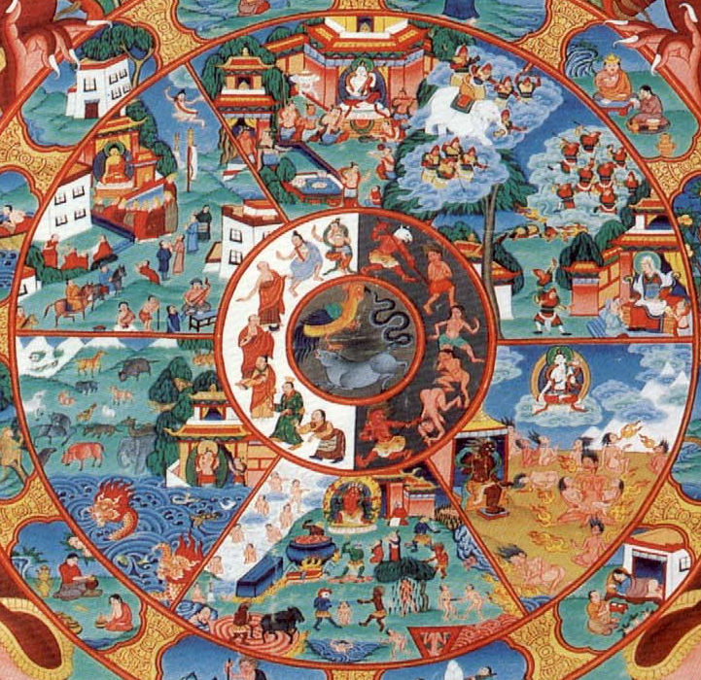
The Wheel of Rebirth
Six Realms of Existence
Gods
Asuras (Lesser Gods or Demigods)
Humans – Best Position b/c Awakening is possible
Animals
Pretas (Avaricious Spirits or Hungry Ghosts)
Hell Dwellers (Cold Hells and Hot Hells)

Slide 53
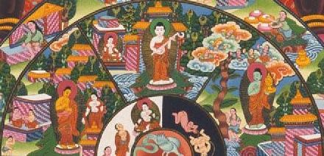
The Wheel of Rebirth Desirable Rebirths

Slide 54
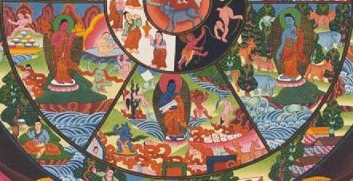
The Wheel of Rebirth Undesirable Rebirths

Slide 55
5.2 Nirvana
Nirvana is a central term in Buddhism, but it is difficult to define.
Remember that “nirvana” means “extinguishing” and thus is connected to the previously mentioned image of rebirth as being like one flame lighting another.
The Buddha himself did not say much about it; later Buddhists proposed varying explanations. It has been defined as the extinction of aging, and dying has been defined as escape from suffering.

Slide 56
5.2 Nirvana
Nirvana may be attained while one is still alive, and at death such a person is not reborn.
Therein lies some of the difficulty in defining the term, for if all that remains after one dies is karma, what is left to experience nirvana for the person who no longer has any karma?

Slide 57
5.2 Nirvana
The Buddha apparently chose not to try to describe this state any further, explaining that to do so would not lead people toward nirvana.
The arhant (Pali: arhat) is the “worthy one” who has found nirvana in this life; at death the arhant enters the ultimate state of nirvana.

Slide 58
5.3 The spread of Buddhism
Buddhism spread throughout India, aided by leaders such as King Ashoka, but essentially died out there by the twelfth century.
Buddhism in a variety of forms spread throughout Asia.
There is a major division between Theravada (Way of the Elders; south) and Mahayana (Great Vehicle; north) Buddhism

Slide 59
5.3 The spread of Buddhism
Buddhism spread throughout India, aided by leaders such as King Ashoka, but essentially died out there by the twelfth century.
Buddhism in a variety of forms spread throughout Asia.
There is a major division between Theravada (Way of the Elders; south) and Mahayana (Great Vehicle; north) Buddhism

Slide 60
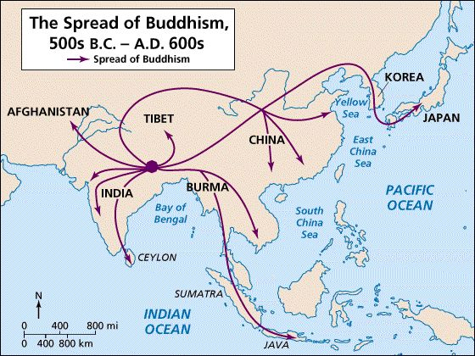
5.3 The spread of Buddhism

Slide 61
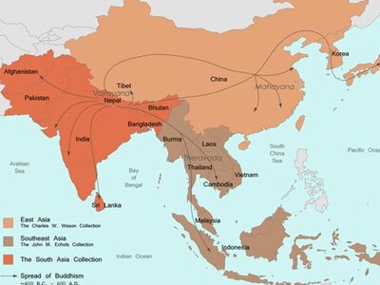
5.3 The spread of Buddhism

Slide 62
5.3 The spread of Buddhism
Theravada is prevalent in the Southeast Asian countries of Sri Lanka (which geographically is in South Asia), Myanmar (formerly Burma), Thailand, Cambodia, and Laos.
Mahayana is dominant in China, Korea, Mongolia, Vietnam, Japan, Nepal, and Tibet.
Both groups are in general agreement about the basic concepts of the Four Noble Truths, karma, samsara, and nirvana.

Slide 63
5.3 Theravada: mindfulness
Theravada seeks to maintain what it considers the original teachings of Buddhism.
At the popular level, devotional practices dominate. Theravada’s central text is the Pali Canon, also known as the Tipitaka or “three baskets” (so named because manuscripts were stored in baskets) of rules of monastic discipline, Dharma teachings, and scholastic treatises.

Slide 64
5.3 Theravada: mindfulness
Theravada seeks to maintain what it considers the original teachings of Buddhism.
At the popular level, devotional practices dominate. Theravada’s central text is the Pali Canon, also known as the Tipitaka or “three baskets” (so named because manuscripts were stored in baskets) of rules of monastic discipline, Dharma teachings, and scholastic treatises.

Slide 65
5.3 Theravada: mindfulness
Buddhist tradition recalls that Buddhist elders compiled the Pali Canon after the Buddha’s death.
Its various portions were initially transmitted orally until the sutras (Pali: suttas) were written down in the first century BCE.

Slide 66
5.3 Theravada: mindfulness
Theravada Buddhism highlights the Triple Gem or Three Refuges of the Buddha, Dharma, and the Sangha.
Indeed, one becomes a Buddhist by reciting a formula stating that one takes refuge in each part of the Triple Gem

Slide 67
5.3 Theravada: mindfulness
The Theravada monastic order traces back to the time of Buddha himself; Theravadin monks live very simple lives. They depend on the support of laypeople, who, in turn look to them for teaching and guidance.
In Theravada Buddhism, it is common for young men to become monks temporarily; there is no stigma attached to leaving the monastic order.

Slide 68
5.3 Theravada: mindfulness
The text notes that while an order of nuns did exist in the Buddha’s lifetime, it did not survive. Some Buddhist texts reveal misogynist attitudes. In 1998, however, 135 nuns were ordained at Bodh Gaya.
Theravada transmits various meditation techniques known under the general headings of samatha (calm) and vipassana or “insight.”

Slide 69
5.3 Theravada: Devotional Practices
In addition to the contemplative and philosophical traditions, many lay Buddhists and also many monastic practitioners of Theravada Buddhism of Southeast Asia turn to the Buddha himself in their devotional practices.
Many lay rituals seek to derive benefit from the power of the Buddha present in his image, his relics, and the chanting of his teachings or the sutras.

Slide 70
5.3 Theravada: Devotional Practices
Buddha images are specially consecrated.
Buddhist temples are important community centers, not only for generating and distributing the power of the Buddha but also community identity and integration.
It is important to note that Buddhism has typically combined with indigenous spiritual practices.
Although some scholarship on Buddhism (both in the West and in Asia) has portrayed popular devotional practices as antithetical to the spirit of Buddhism, much current research suggests that these practices have long been part of mainstream Buddhism.

Slide 71
5.3 Mahayana: compassion and wisdom
Mahayana (a general category with many branches) reflects innovation in Buddhist thought and practice, including a focus on the liberation of all beings, whether monastic or laypeople, and a vast array of Buddhas and bodhisattvas.
Wisdom and compassion, as well as the skillful means needed to cultivate awakening, are key virtues in Mahayana.

Slide 72
5.3 Mahayana: compassion and wisdom
Mahayana scriptures emphasize that all beings have the capability to achieve Buddhahood and encourage people to embark on the path to becoming a bodhisattva (being dedicated to attaining enlightenment; note that this is also the term used for the Buddha himself in his previous lives).

Slide 73
5.3 Mahayana: compassion and wisdom
Aspiring bodhisattvas take a series of vows to mark their commitment to save others from suffering.
East Asia’s most popular bodhisattva, Avalokiteshvara, is known as Guanyin in China and Kannon in Japan and is most commonly portrayed as a female who bestows and protects children.

Slide 74
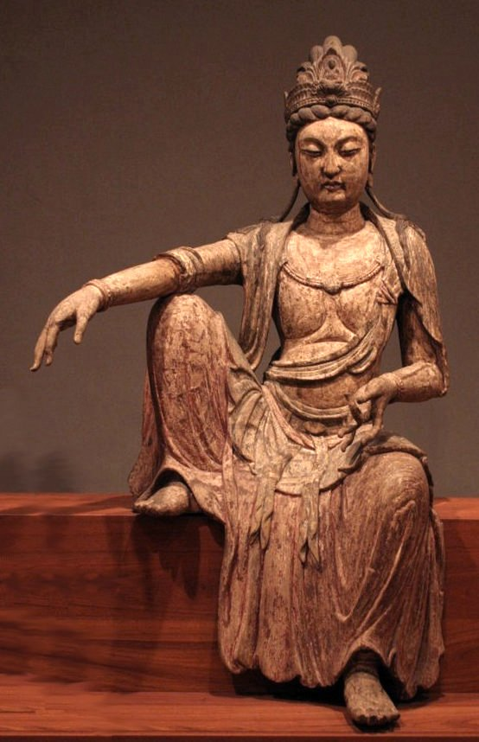
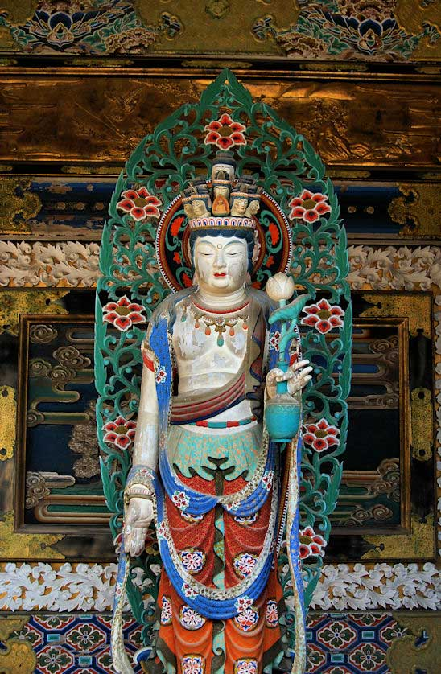
5.3 Mahayana: compassion and wisdom

Slide 75
5.3 Mahayana: compassion and wisdom
Theravada Buddhism regards the Buddha as a historical figure who no longer exists but who left his Dharma as a guide.

Slide 76
5.3 The Three Bodies of Buddha
In contrast, Mahayana teaches that the Buddha is a universal principle in
1. the enlightened formless wisdom body;
2 the celestial bliss body, which communicates the Dharma to bodhisattvas;
3 and the emanation of the body whereby a Buddha manifests in countless forms to help liberate suffering beings.

Slide 77
5.3 Mahayana: compassion and wisdom
One of the most fascinating and challenging philosophical concepts in Mahayana thought is shunyata (“voidness” or “emptiness”).
Building on the basic Buddhist idea that all things depend on something else (whether physical objects or concepts) and have no independent origin and no eternal reality, Mahayana thinkers argued that the world of death and rebirth is empty of inherent existence.

Slide 78
5.3 Mahayana: compassion and wisdom
Even the Four Noble Truths are empty; nirvana, too, is empty insofar as it is a thought construct, though it does not depend on conditions.
Teachings on emptiness do not mean we do nothing but that we do not become attached to results. Instead, the focus of emptiness is on compassion, skillful means, and the wish to benefit all living beings.

